Slide 1
Content Analysis (Part II)
Week 8 Lecture
Becoming a Political Researcher (POL2017)

Slide 2
Join the Vevox session
Go to vevox.app Enter the session ID: 196-472-727 Or scan the QR code
Any questions about what we have covered so far?
Surveys
Content analysis

Slide 3
Recap
Last week
What is content analysis?
Types of content analysis
Case selection
Labelling our content
Validity and reliability

Slide 4
What is content analysis
Content analysis:
Systematic analysis of texts or other media
Can analyse a wide variety of documents
Across huge range of issues
Unobtrusive method of data collection
Can examine otherwise inaccessible subjects
Can’t explore subsequent effects of the content

Slide 5
Types of content analysis
Quantitative
Positivism
Validity, reliability
Manifest content
Qualitative
Interpretivism
Plausibility
Latent content
Inductive and deductive approaches

Slide 6
Evaluating content analysis
Qualitative content analysis
Plausible categories
Explanation of coding decisions
Quantitative content analysis
Internal and external validity
Intra and inter-coder reliability

Slide 7
Stages of a content analysis
Research questions/hypotheses
Case selection
Units of analysis
Categories
Coding
Analysis

Slide 8
Coming up
Today
Where to get data for content analysis
Doing our own content analysis
Examples in academic research
Related methods
Mid-semester feedback

Slide 9
This week
Assigned course materials:
Review last week’s assigned readings: Halperin & Heath; Bryman
Moffitt (2024). How do populists visually represent ‘the people’? A systematic comparative visual content analysis of Donald Trump and Bernie Sanders’ Instagram accounts.
Godefroidt, Berbers & d’Haenens (2016). What’s in a frame? A comparative content analysis of American, British, French, and Russian news articles.
Seminar questions:
How do we develop categories for content analysis?
Where/how can we collect data for our content analysis research?
What do you think are some of the main issues/limitations we would need to take into consideration if we wanted to conduct our own content analysis project?

Slide 10
Where can we collect data for content analysis?

Slide 11
Data collection
Can manually collect documents ourselves
Can look for existing databases or collections
Consider:
What type of documents do I need?
How many?
Which aspects of the documents are relevant?

Slide 12

Data sources
Manifesto project
Party websites
Candidate websites
Open Elections

Slide 13
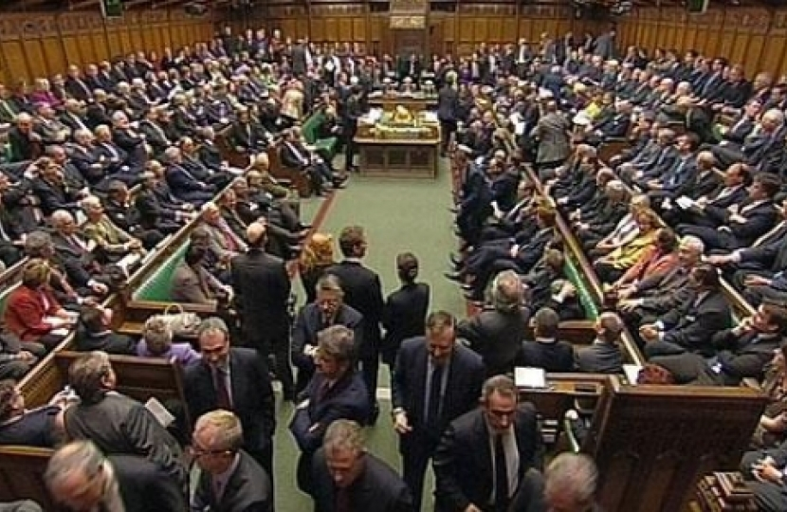

Data sources
Hansard
UN Digital Library
ParlEE
They Work For You

Slide 14
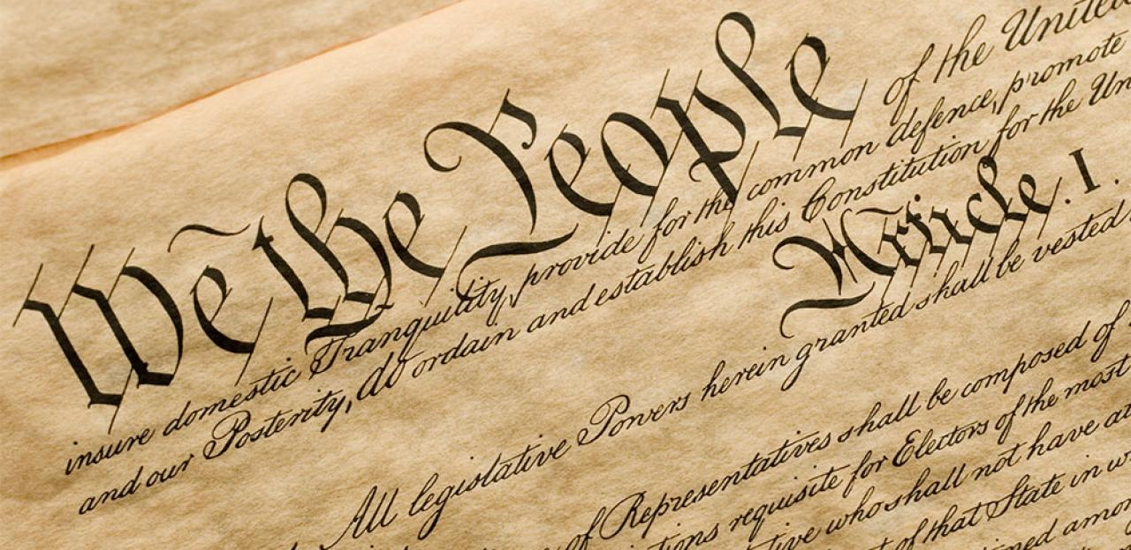


Data sources
Constitute
OSCE Election Reports
Human Rights Reports

Slide 15
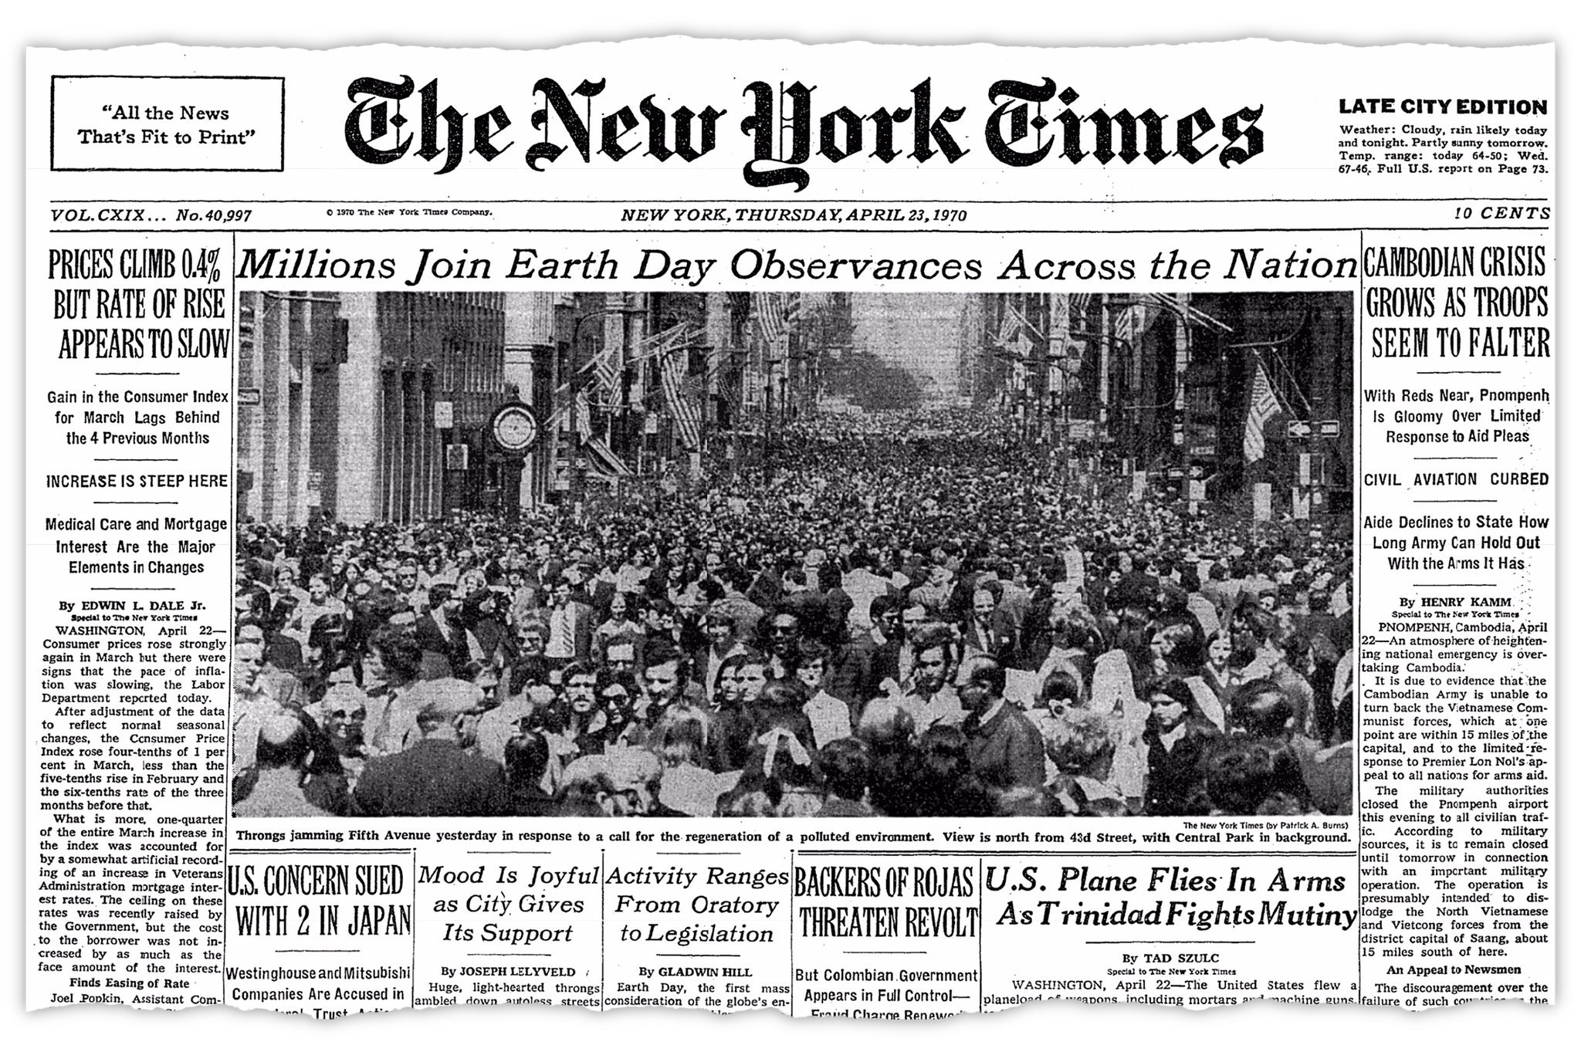

Data sources
News websites
Nexis
Box of Broadcasts

Slide 16

Data sources
X API
Crowdtangle
Growing issues with access to social media data

Slide 17
Data sources
Download and save copies of the documents
Check any copyright licensing/terms of use
Take notes of where and how you collected the data
Will make writing method section easier!

Slide 18
Doing content analysis

Slide 19
Considerations
What features of the document are relevant?
Just the raw text, or formatting important?
Video file, or written transcript?
What size of coding unit will you use?
Data storage/organisation
Data cleaning & processing

Slide 20
Software and Data
Custom content analysis software is available
Nvivo, Textstat
But can also use Excel or Google sheets

Slide 21
Where do you store your files for uni work?
##/##
Join at: vevox.app
Question slide
ID: XXX-XXX-XXX
Cloud storage (googledrive/dropbox/onedrive)
##.##%
Everything lives and dies in the downloads folder
##.##%
Keep my files together in folders
##.##%
No idea
##.##%

Slide 22
Where do you store your files for uni work?
##/##
Join at: vevox.app
Results slide
ID: XXX-XXX-XXX
Cloud storage (googledrive/dropbox/onedrive)
##.##%
Everything lives and dies in the downloads folder
##.##%
Keep my files together in folders
##.##%
No idea
##.##%
RESULTS SLIDE

Slide 23
Data storage tips
If downloading a dataset ‘.csv’ files often best option
If just interested in text content can save as ‘.txt’
Create a folder to store all original files
Give each document a unique identifier
File naming
Leading zeros
ISO dates ‘2023-03-19’

Slide 24
Content analysis in practice
Media bias on BBC Question Time
What forms of political bias is the show accused of?
Dependent variables
Who is accused of bias?
Biased for/against which group?

Slide 25
Content analysis in academic research Example 1

Slide 26
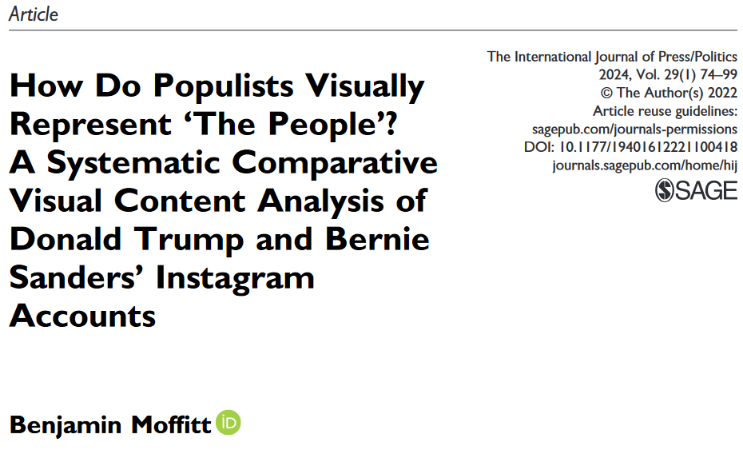

Slide 27
Moffitt (2024)
Visual content analysis
How do populists visually represent the people?
Gender, race, age
US 2019, Instagram posts of Trump and Sanders
Right-wing and left-wing populism

Slide 28
Please place each politician where you think they belong on the following two 0-10 scales
##/##
Join at: vevox.app
Question slide
ID: XXX-XXX-XXX
10
Bernie Sanders
P o p u l i s t
Donald Trump
Jeremy Corbyn
Nigel Farage
Rightwing
10

Slide 29
Please place each politician where you think they belong on the following two 0-10 scales
##/##
Join at: vevox.app
Results slide
ID: XXX-XXX-XXX
10
Bernie Sanders
P o p u l i s t
Donald Trump
Jeremy Corbyn
Nigel Farage
RESULTS SLIDE
Rightwing
10

Slide 30

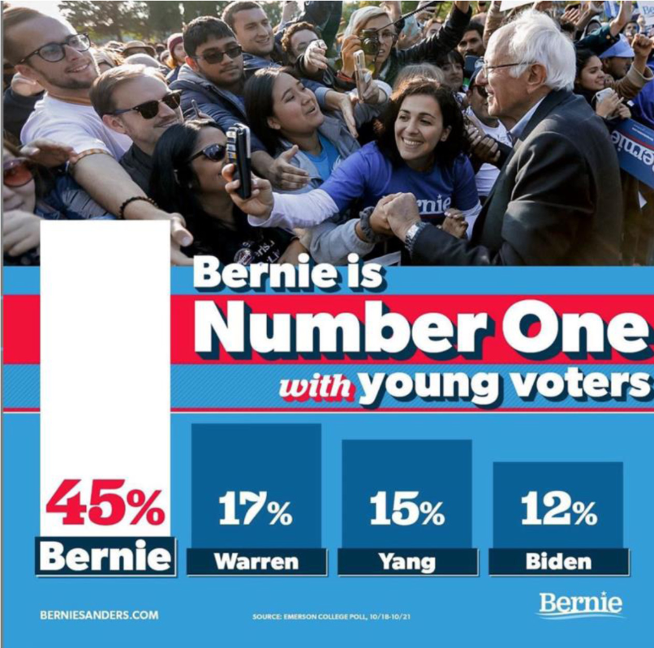

Slide 31



Slide 32
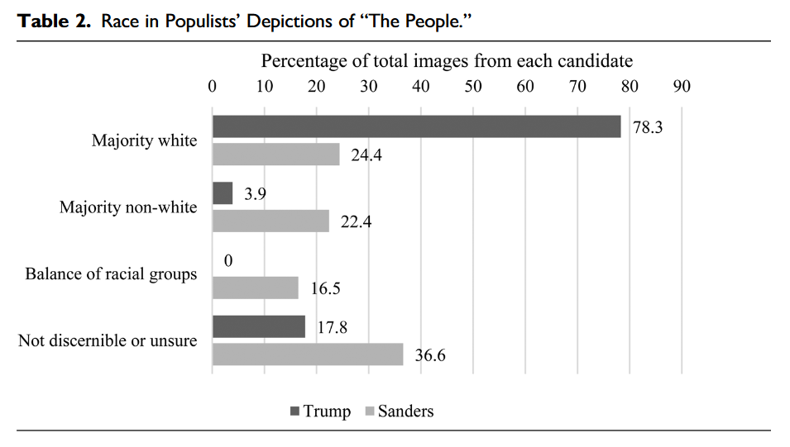

Slide 33
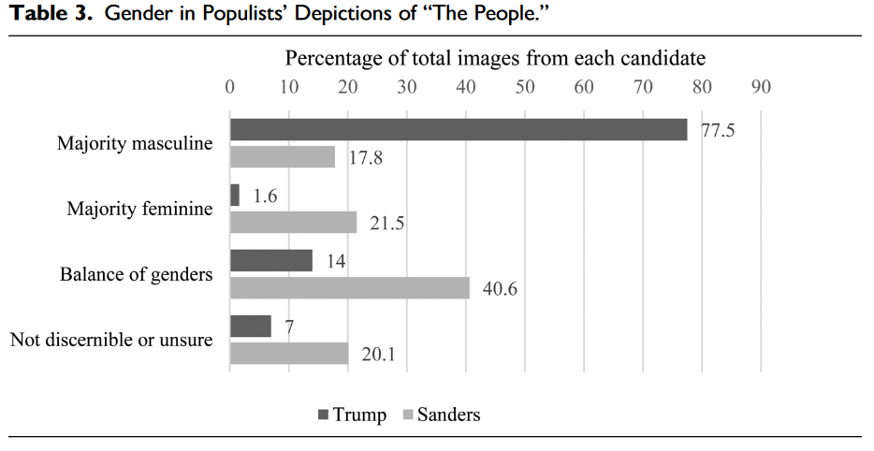

Slide 34
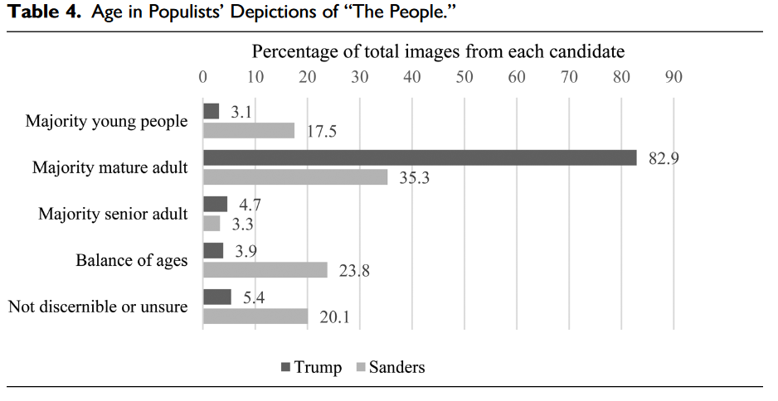

Slide 35
Alternative approaches to text analysis

Slide 36
Related methods
We can analyse texts/documents using:
Content analysis
Quantitative and qualitative
Discourse analysis
Some common features with qualitative content analysis
Quantitative/Computational text analysis
Quantitative content analysis at scale using computational tools
Discourse analysis
Computational text analysis
Content
analysis

Slide 37
Discourse analysis
Discourse as the words, texts, images, behaviours and actions that shape how we experience the world
Analysing the relationship between discourse and reality in a particular context
Post-structuralist discourse theory
The way people talk about the world reflects not some objective truth, but the success of particular ways of thinking and seeing

Slide 38
Discourse analysis
The study of language use in context
Broad context
Cultural norms and assumptions, knowledge, beliefs
Local context
Immediate situation, source and intended audience

Slide 39
Context
Discursive Practices
Texts

Slide 40
Context: Existence of racism
Discursive Practices: Pressures on journalists
Texts: Newspapers

Slide 41
Context: Government policy, economy, social norms
Discursive Practices: Pressures on Universities
Texts: Course lists

Slide 42
Discourse analysis
Advantages
How language shapes meaning
Context beyond text
Social structures that produce texts
Limitations
Theory & method overlap
Subjective, complex

Slide 43
Quantitative text analysis

Slide 44
Computational text analysis
Machine learning
Supervised
Semi-supervised
Unsupervised
Applications
Classification
Generative
Positivist
Data science, linguistics, natural language processing

Slide 45
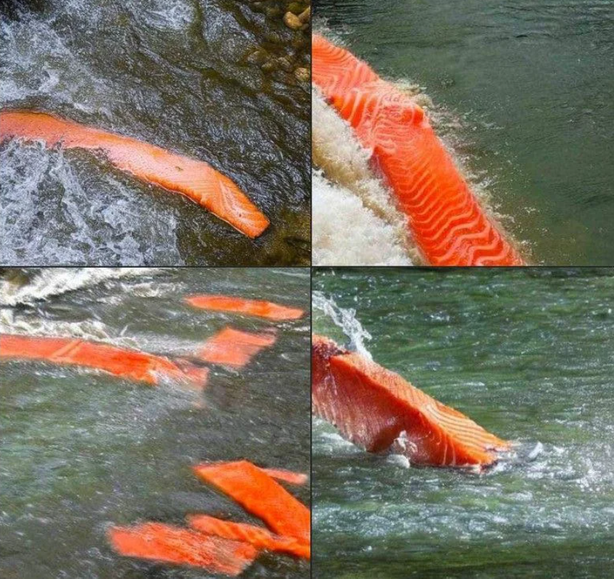
“Salmon in the river” generated by Dalle-2

Slide 46

“Nurse treating a patient” and “Doctor treating a patient”
Source: https://medium.com/@noa_lubin/dall-e-2-creativity-is-still-biased-3a41b3485db9

Slide 47
“What is the single most important issue facing the country at the present time?”
- Open ended text response
- We now want to group responses into issue categories
Survey Response
Funding for cancer drugs
Defence
economic recovery
Getting the Tories out so they stop ruining everything
Immigration
Source: British Election Study

Slide 48
“What is the single most important issue facing the country at the present time?”
- Open ended text response
- We now want to group responses into issue categories
Survey Response (coded issue category)
Funding for cancer drugs (NHS)
Defence (international probs)
economic recovery (economy general)
Getting the Tories out so they stop ruining everything (politics-neg)
Immigration (immigration)
Source: British Election Study

Slide 49
“What is the single most important issue facing the country at the present time?”
What do you think would be the advantages, or issues we might face if we tried to code these responses by:
Labelling all the responses ourselves
Having a team of 2 coders label the responses
Using keyword searches to label each response
(Time, cost, validity, reliability)

Slide 50
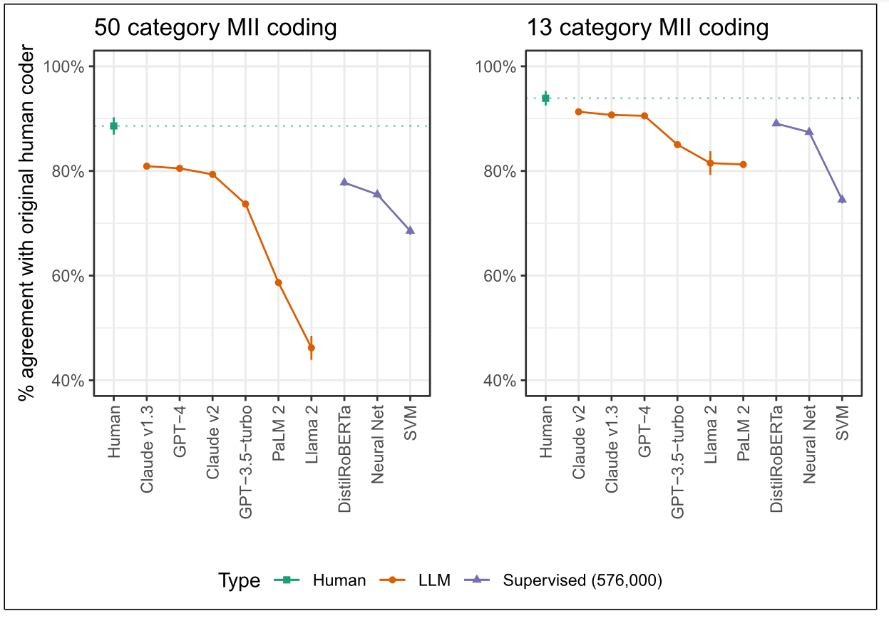

Slide 51
Computational text analysis
Limitations
Technical skills
Training data quality/bias
Requires validation
Advantages
Scalable
Flexible
Time and cost

Slide 52
Content analysis in academic research Example 2

Slide 53
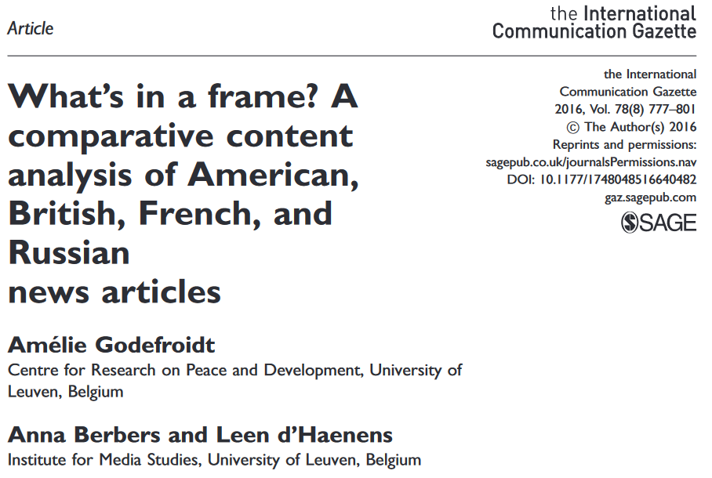

Slide 54

Godefroidt et al. (2016)
Agenda setting
Framing
Deductive quantitative content analysis
News coverage of Syrian civil war
Before and after chemical weapons attack

Slide 55
Research Questions
How much attention is paid to the Syrian war in newspaper coverage?
Which news frames do the newspapers frequently apply?
How are blame and solutions included in these frames?

Slide 56
Case selection
New York Times (US)
The Telegraph (UK)
Le Figaro (France)
The Moscow Times (Russia)
July-October 2013
Random sample 42 days
574 articles
Inter-coder checks
Articles containing the following words:
uprising, rebellion, revolt, revolution, crisis, rebel, fight, war, or civil war and Syria, Syrian, or Assad

Slide 57
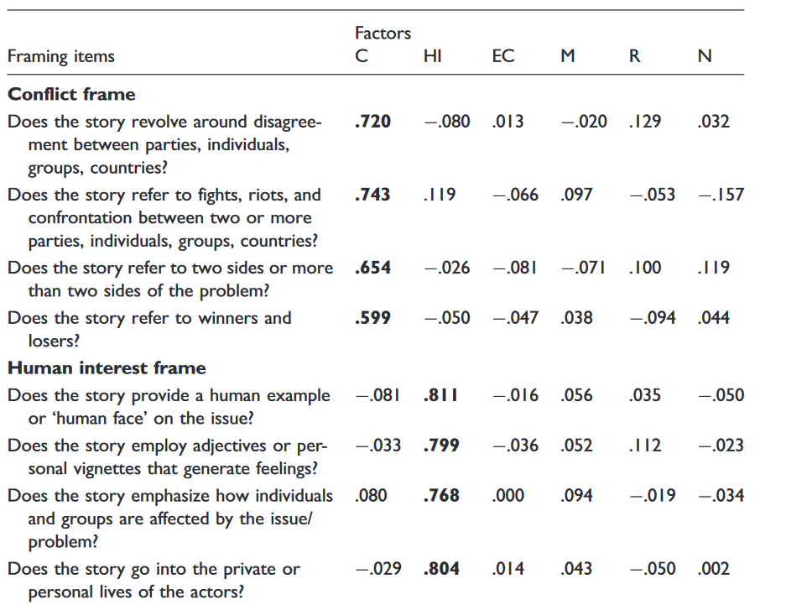

Slide 58
Join the Vevox session
Go to vevox.app Enter the session ID: 196-472-727 Or scan the QR code

Slide 59
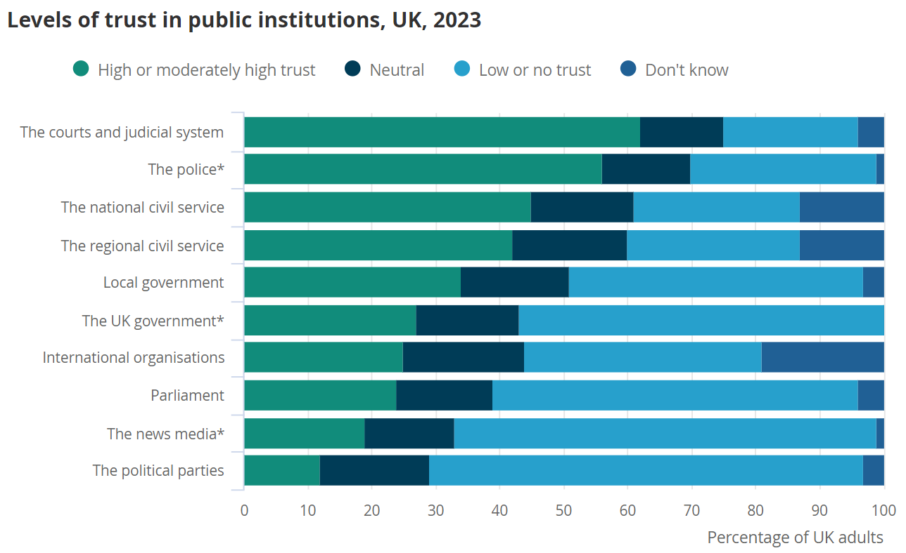
Source: ONS

Slide 60
Results
Emphasised
Nationalisation
Responsibility
Conflict
Downplayed
Morality
Human interest
Economic impact
Lack of wider context in reporting
Solutions discussed in line with government aims

Slide 61
Mid-semester feedback

Slide 62
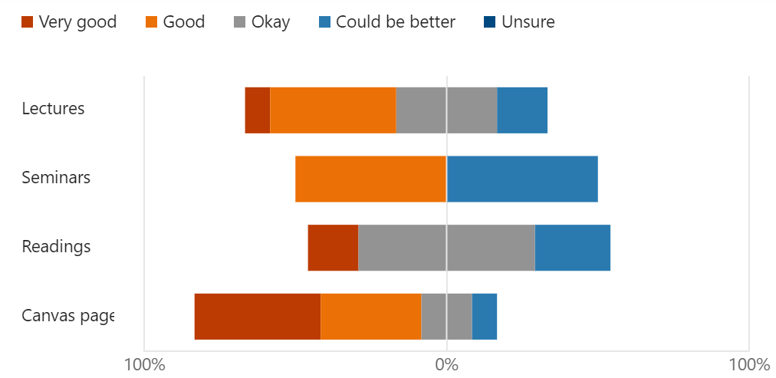
Mid-semester feedback
12 responses (7% response rate)

Slide 63
Mid-semester feedback
Best features
Useful learning for dissertation
Assessment guidance
Reading not extensive/too complex
Seminar discussions

Slide 64
Mid-semester feedback
What could be improved
More engagement in lectures and seminars
Seminars being more tied to readings and lectures
Lecture/seminar timing
Project based assessments

Slide 65
Coming up
Week 9 – Interviews I
Week 10 – Interviews II
Week 11 – Exam preparation
Digital Exam 22nd May

Slide 66
Questions
Any questions about what we have covered so far?
Surveys
Content analysis

